Slide 1



Studio Shodwe
CUSTOMER BOOKING BEHAVIOR ANALYSIS
Presented by: Arum Puri

Slide 2

OVERVIEW
Analyze customer booking behavior to identify patterns and factors influencing booking completion.
Build predictive models to forecast booking completion rates.
50,000 records with 14 features.
Features include numerical (e.g., purchase_lead, length_of_stay) and categorical variables (e.g., sales_channel, flight_day).

Slide 3
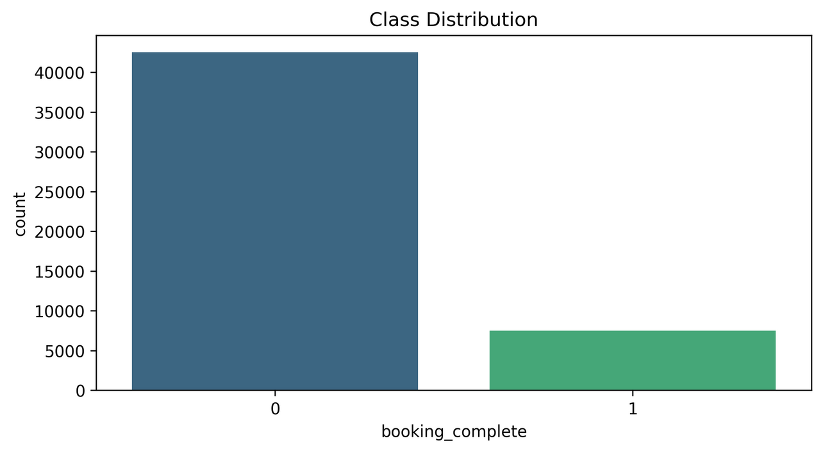

BOOKING COMPLETION
BOOKING COMPLETION RATE
Overall booking completion rate: 14.96% .
Imbalanced dataset: 85% incomplete bookings vs. 15% complete bookings.

Slide 4

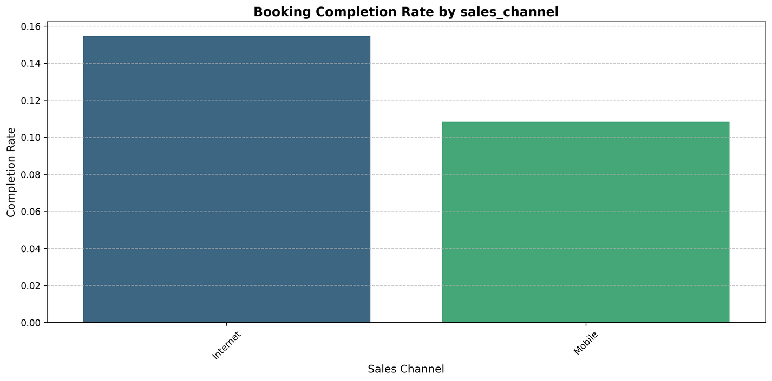
SALES CHANNEL PERFORMANCE
Mobile bookings: 10.84% completion rate
Internet bookings: 15.48% completion rate
Internet is the dominant channel (88.76% of all bookings)

Slide 5
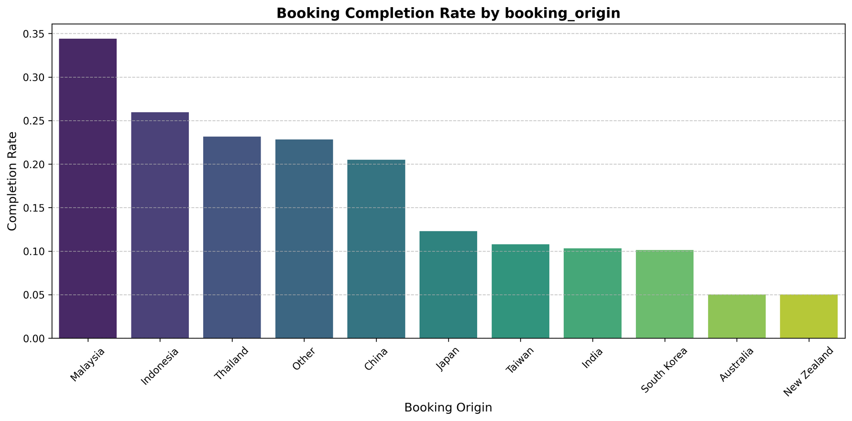
CUSTOMER ORIGINS
Malaysia (34.40%)
Indonesia (25.96%)
Thailand (23.15%)
China (20.49%)

Slide 6
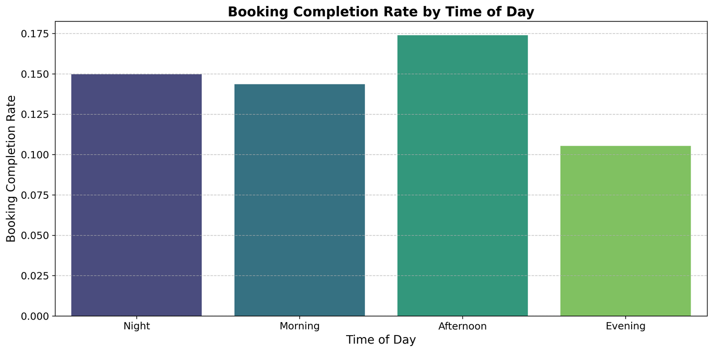

Booking Patterns
Temporal Analysis
Day of Week: Wednesday shows highest completion rate (16.31%)
Time of Day: Afternoon bookings show better completion rates
Weekend vs. Weekday patterns show minimal variation

Slide 7
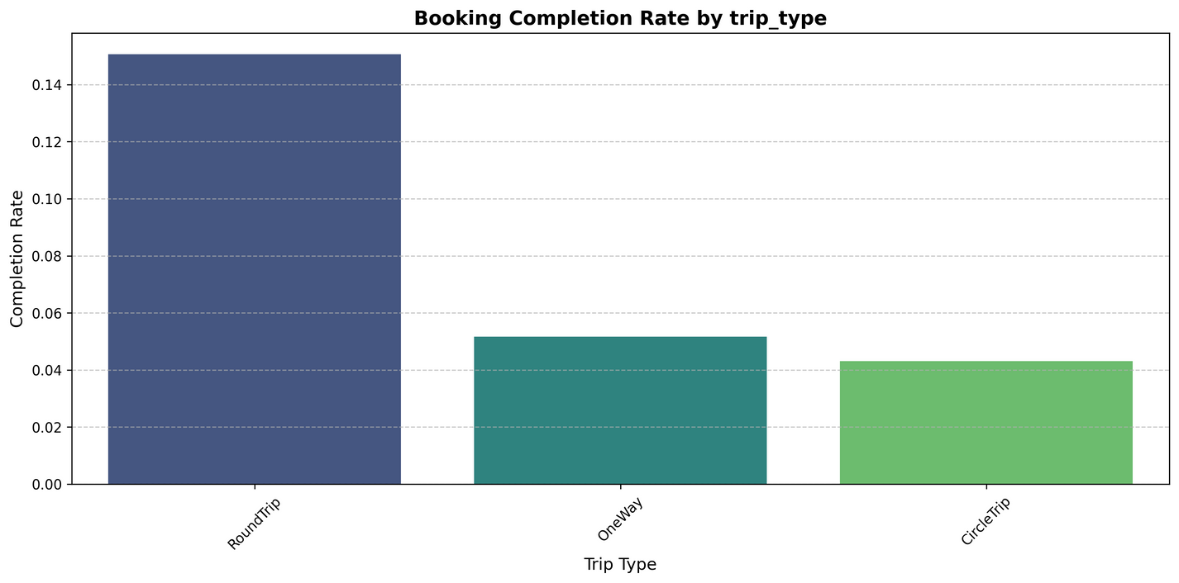
Booking Patterns
Trip Characteristics
RoundTrip dominates (98.99% of bookings)
Longer stay durations correlate with higher completion rates
Purchase lead time shows significant impact on completion

Slide 8
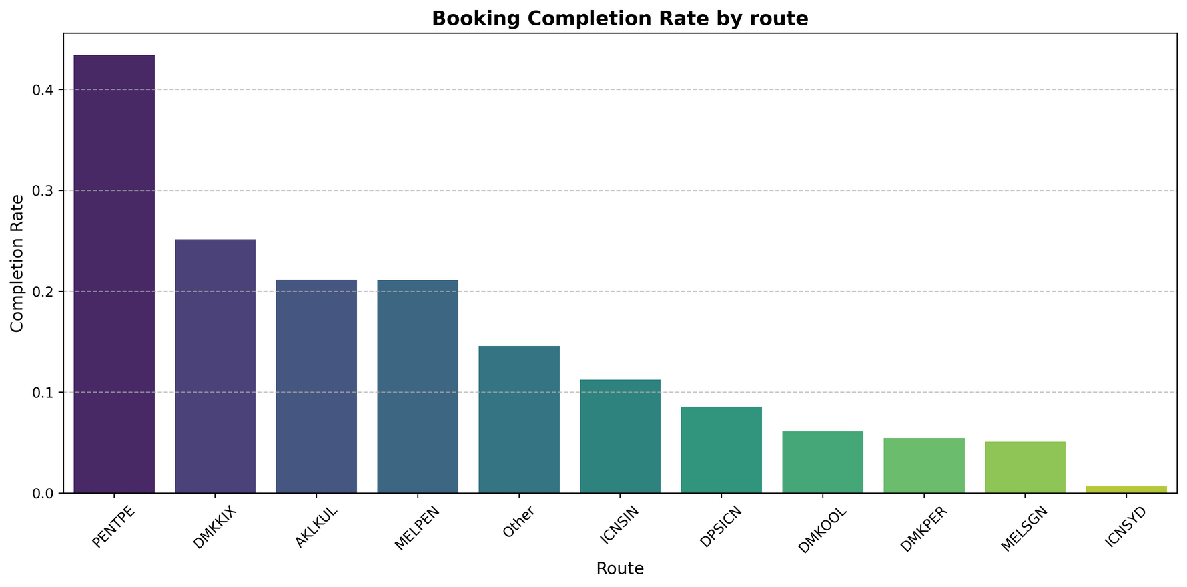
ROUTE ANALYSIS
PENTPE (43.40% completion)
DMKKIX (25.13%)
AKLKUL (21.16%)

Slide 9


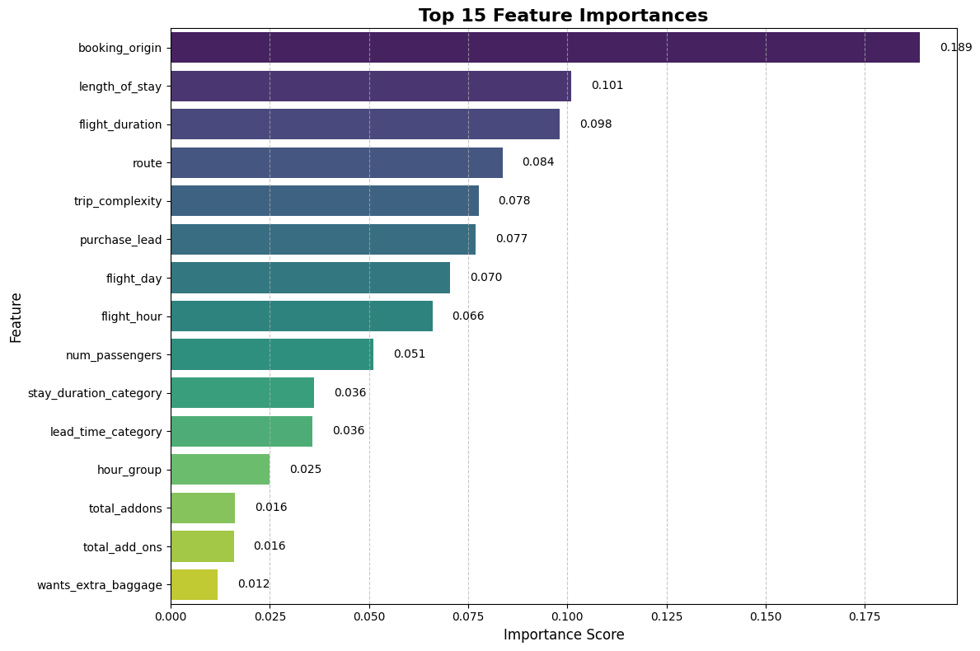

PREDICTIVE FACTORS OF RANDOM FOREST MODEL
Key Influencing Features (Based on Model Analysis)
Purchase lead time
Length of stay
Booking origin
Route
Total add-ons
Model Performance
ROC-AUC Score: 0.974 (±0.048)
High precision for non-completed bookings (0.87)
Good overall accuracy (0.84)

Slide 10

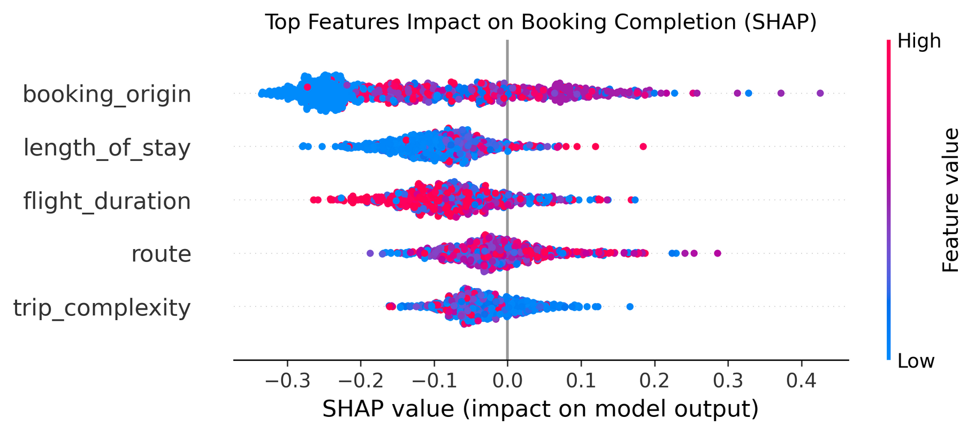
SHAP value summary plot

Slide 11

SHAP (SHAPLEY ADDITIVE EXPLANATIONS) VALUES PLOT
Booking origin has the widest spread of impact, suggesting it's highly influential
Length of stay shows moderate impact, with some clear patterns between longer/shorter stays
Flight duration shows a fairly symmetric distribution of impact
Route and trip complexity have relatively concentrated impacts around the center
Most features show both positive and negative impacts depending on their values

Slide 12


RECOMMENDATIONS
Short-term Actions
Focus on improving mobile channel performance
Optimize booking experience for high-value routes
Promote add-on services earlier in booking journey
Long-term Strategies
Develop targeted marketing for high-performing regions
Implement route-specific pricing strategies
Enhanced mobile platform development

Slide 13


Studio Shodwe
Thank's For Watching
Connect with us.
+123-456-7890
hello@realltrtrtsite.com

